Slide 1
BETWEEN ART AND AUTOMATION
11/8/2013
Regine Heberlein, Princeton University
The Quest
for the Sustainable CPF Record
Notes:
My name is Regine Heberlein; I’m an archivist at Princeton University. I’m part of a working group composed of archivists, library systems staff, and a cataloger, that has worked on EAC-CPF for the last year and a half. It is chaired by Dan Santamaria and includes Don Thornbury, Jon Stroop, Shaun Ellis, and John Delaney. (It also used to include Maureen Callahan, who is now at NYU.)
Our project is very much a work still in progress. I would like to share with you some of the considerations that went into our project and how we have chosen, for the moment, to resolve them.

Slide 2
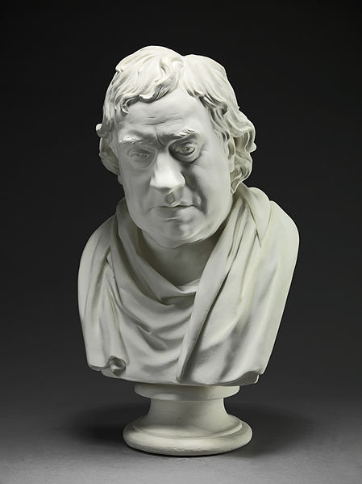
ART
11/8/2013
Regine Heberlein, Princeton University
Joseph Nollekens,
Samuel Johnson.
Plaster, 1777.
Yale Center for British Art
Notes:
One question we found ourselves faced with early on was just how far we wanted to take CPF at Princeton. Harvard and Yale, with their Project “Connecting the Dots: Using EAC-CPF to Reunite Samuel Johnson and His Circle,” gave the archives community a wonderful proof of concept demonstrating that you could go VERY far indeed with all the information you could pack into a CPF record.
I think of this end of the spectrum of crafting a CPF record as the artisanal, even artistic mode. This kind of rich CPF record needs to be hand-produced in small batches by masters of the craft: because making these requires a certain skill set (including research skills and subject expertise) and a good amount of time and patience.

Slide 3
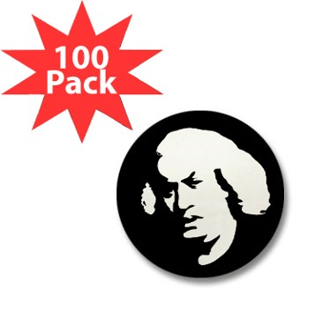
AUTOMATION
11/8/2013
Regine Heberlein, Princeton University
"Samuel Johnson" Mini Button (100 pack)
www.cafepress.com
Product #61003309
Notes:
On the other end of the production spectrum, you might imagine a fully automated workflow, with minimal human intervention beyond designing and maintaining the system. This is more of a mass-production approach--a highly efficient but inherently dumb system that foregoes research and crafty writing in favor of assembling data from structured sources in meaningful new ways. This would be my personal ideal, but it requires extremely well-structured input data that few if any of us have.
Before we embarked on this project, we had to articulate somewhat explicitly where we would fall on the spectrum. How far exactly did WE want to got with our CPF records?

Slide 4
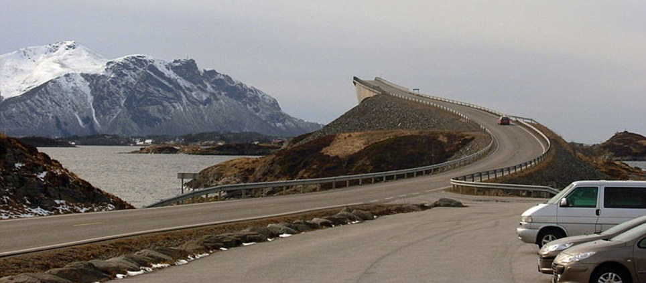
NOT THIS FAR
11/8/2013
Regine Heberlein, Princeton University
http://www.dailymail.co.uk/news/article-2056698/The-road-Norwegian-bridge-gives-motorists-fright-dont-worry-just-optical-illusion.html
Notes:
We decided that for us, handcrafting CPF records might be a road to nowhere, because for what we wanted to achieve (I’ll get to that in a moment), it would be so time-consuming that the project would inevitably peter out sooner or later. We wanted to be sure there was an achievable goal at the end of our road.
So how much time would it take? The reference point given us by the Harvard/Yale project’s record creation study is an average of about 4 hrs per record.
https://wiki.harvard.edu/confluence/display/connectingdots/Record+creation+time+study
We have about 16k unique names in our collections. At under 2 records per day, it would cost us 64k man hours to make CPF records for all of them (or, assuming one dedicated staff member, 30 years. That’s the year 2043, and not accounting for either vacation or collection growth!)

Slide 5
Structured Access
Persons / Corporate Bodies / Families Description (EAC-CPF)
Record Description (EAD)
Function Description (EAC-F)
Notes:
For us, the goal of creating CPF records is to provide structured access to as many archival resources as possible. One way of doing that is by providing structured access to Corporate Bodies/Persons/Families records that act as a gateway (access point) to resource data.
Eventually, we’ll want to accomplish the same for functions, and I’ve included the functions module on this slide for the sake of completeness, to show you where we think our road is headed, even though that bit is still wishful thinking at the moment.

Slide 6
PRINCIPLES
11/8/2013
CPF records are not a goal unto itself but access points
More access points are better than fewer access points
Concise access points are sufficient
Additional content is created at the expense of resource discovery
Regine Heberlein, Princeton University
Notes:
With this goal in mind, to provide structured access to as many archival resources as possible, we reached some theoretical conclusions that informed our project:
CPF records serve as access points for resource discovery.
As such, more access points created over the same period of time are more desirable than fewer access points.
Concise access points are sufficient. The records need to be exactly rich enough to provide access to the resource. Then stop.
Content created beyond that function is created at the expense of the creation of other access points, i.e. at the expense of resource discovery.

Slide 7
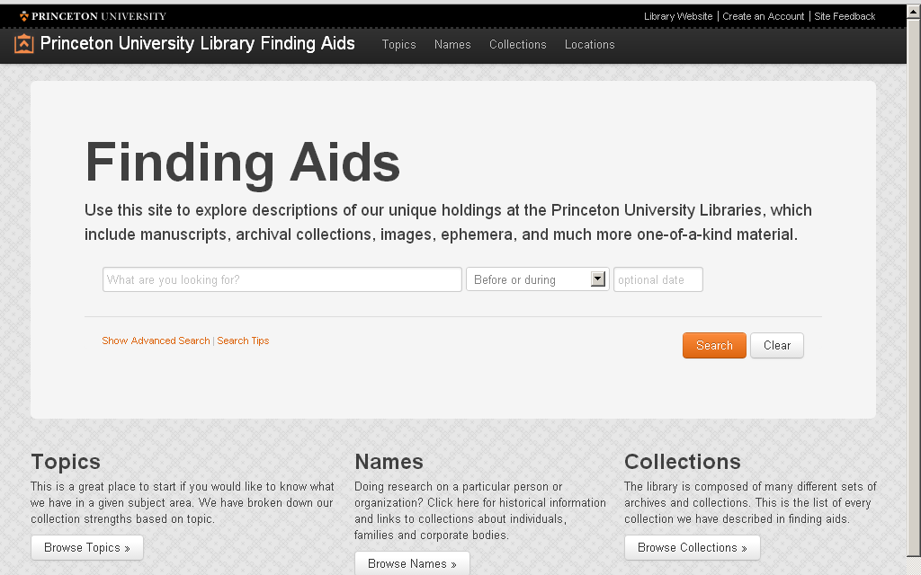
11/8/2013
Regine Heberlein, Princeton University
Notes:
So we conceived of our Names module as a platform that would allow patrons to start their exploratory research. It allows researchers who are still working on refining their interests to cast a wider net to find and identify pertinent resources.
Let me demonstrate a brief sample search.
Video here

Slide 8
CONTEXT V. AUTHORITY
11/8/2013
“American novelist and Nobel Prize winner Ernest Hemingway and Milford J. Baker drove ambulances together on the Italian front in 1918 and later shared big-game hunting and gun-collecting interests.”
Regine Heberlein, Princeton University
Notes:
As you can see, the heart of the matter here is the list of resource relations, the links that take the researcher to collections related to Hemingway.
That’s where we currently stand on the level of exhaustiveness of our CPF records.
I want to take a closer look at the biograpy section in our CPF records to talk about another theoretical consideration: The archival authority record.
Before CPF and the DACS revision, the biographical note provided local context: it served as a means to contextualizing one particular archival resource. It was deliberately incomplete, a snapshot pertaining only to the collection at hand to describe “the context in which the materials being described were created, assembled, accumulated, and/or maintained” (old DACS 2.6), and in many cases derived from the materials themselves.
So in the world before archival authorities, a snapshot biography like this one, [quote], in conjunction with an authorized form of the name, were deemed to give sufficient access to one resource [the Hemingway and Baker correspondence that we just saw].
Now, the archival profession is shifting gears. Archival authorities have a universal scope. They are conceived as normalized access points to *many* resources, both within and especially across repositories. So now we have a problem in terms of repurposing our existing bioghist notes, because this bioghist would not help at all in contextualizing the Walter Houk Collection on Ernest Hemingway, for example, which documents the Houks’s friendship with Hemingway in Cuba.

Slide 9
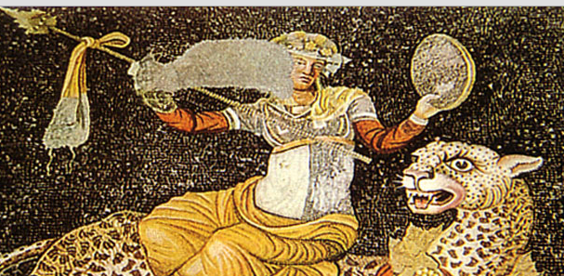
THE MOSAIC COMPROMISE
11/8/2013
Regine Heberlein, Princeton University
Notes:
Given our input data, which consists of bioghist notes that are largely local in scope, making the transition to biographical notes with a broad enough scope for an archival authority record is difficult and requires some human intervention—or a linked data approach where we would point to an outside source (say dbpedia).
We haven’t quite tackled that problem yet. For the moment, we’re taking a mosaic approach by assembling each CPF record from the bioghist notes of all pertinent resource EADs. We may not give an entirely complete picture this way, much like the piece missing from Mr. Dionysos here, but at least it’s complete as far as our own collections are concerned, and it could pass for a recognizable if incomplete representation for collections beyond our walls.

Slide 10
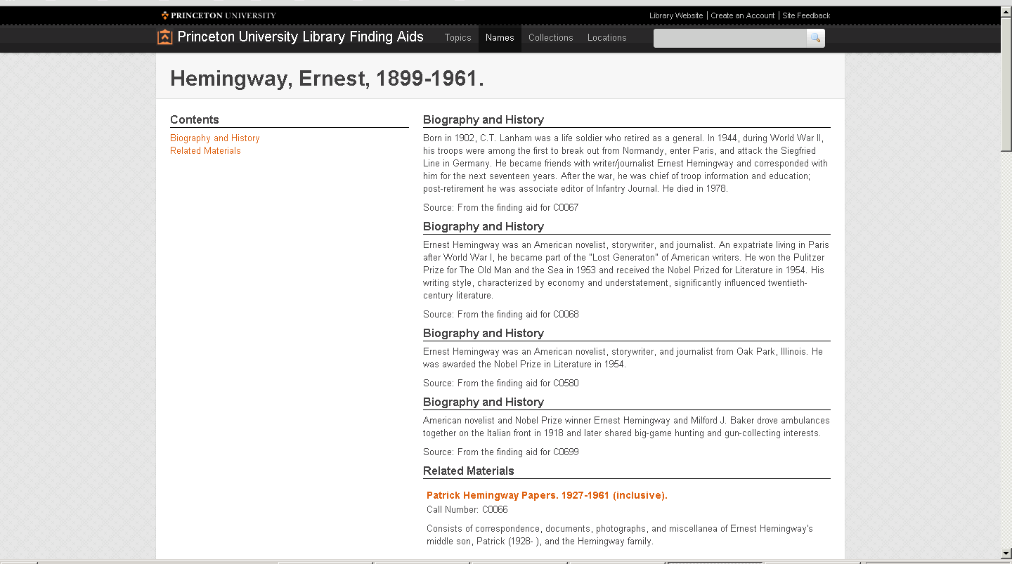
11/8/2013
Regine Heberlein, Princeton University
Notes:
As you can see, each bioghist is displayed with a source statement identifying the resource it is associated with.

Slide 11
HOW MUCH IS ENOUGH?
11/8/2013
For us, at a minimum:
  nameEntry
  biogHist(s)
  resourceRelation (at least one)
Regine Heberlein, Princeton University
Notes:
The mosaic approach was something we could easily accomplish within our largely automated workflow. We derived our CPF records from the EADs using xQuery. For the moment, we decided to create CPF records only for entities that we already had at least one bioghist for in an EAD record, which is 1800 records.
At a minimum, therefore, our CPF records contain a nameEntry, at least one but possibly more than one biogHists, and at least one but possibly more than one resourceRelations.
The resourceRelations are rendered as links directly to the relevant component (this could be a folder or item within a collection, or the collection level). This functionality is made possible by enhancement work on the EADs we did earlier, such that each component has a stable url that doubles as the unique component id.
Our resourceRelations currently support two types of relations, creator of and subject of. We don’t have any immediate plans to expand that, but it’s a possibility.

Slide 12
HOW MUCH IS ENOUGH?
11/8/2013
For us, at most:
  nameEntry
  authorizedForm
  existDates and useDates, if available
  biogHist
  occupations
  resourceRelations (many)
Regine Heberlein, Princeton University
Notes:
At its fullest, a CPF record for us would contain the nameEntry, bioghist, and resourceRelations
as well as an authorizedForm element (many of our names are mapped to LCNAF or VIAF using the @authfilenumber attribute), useDates and existDates that we parse out from the subdivisions in the authorized names, occupations that we derive from the subjects with MARC encodinganalog 656, and resourcerelations.

Slide 13
TO-DO LIST
11/8/2013
Link to CPF from EAD
  and remove bioghist from EAD
Add functions
Move from contextual bioghist model to authority record: human intervention required
Add meaningful useDates
Add search and faceting options
Regine Heberlein, Princeton University
Notes:
In addition, we have a wishlist of things we still want to accomplish.
One big one is to link back to the CPF from the EAD and remove the bioghist note from the EAD. We’re currently thinking about how best to encode that, and we may wait until the EAD3 final tag library is released to see whether there are any changes we need to take under advisement.
The other big-ticket item on our wishlist is to implement EAC-F (ISDF), once it’s a little farther along. This would be especially useful for describing entities in the University Archives collections.
As mentioned, we’re currently thinking about the best approach to link back from a name in the EAD to the corresponding EAC record.
We’re also planning for adding more meaningful useDates—currently, our useDates are derived from the existDates, and this is a project that will probably require some human intervention.
Finally, we’re also actively working on adding improving the search, browse, and faceting functionalities in the Names module (by repository, by level of description…).

Slide 14
11/8/2013
Plan for Maintenance
Regine Heberlein, Princeton University
Notes:
Probably our biggest concern, which we still need to figure out, is how to keep the system sustainable. Whether art or automation, planning for maintenance means allocating resources, and is therefore an intrinsically political process with many different stakeholders (curators, department heads, systems administrators) that need to be on board.
In our system, which is largely automated, sustainability involves an automated maintenance and update schedule that will construct new CPF records and add to existing ones based on additions to the EAD data.

Slide 15
11/8/2013
SNAC
Regine Heberlein, Princeton University
Notes:
One final thought before I leave you. Currently, our Names module is designed to give access to archival resources within Princeton University Library. At the same time, we’re also a contributing institution to Social Networks and Archival Context, or SNAC. We’ve submitted our EAD data to SNAC and are expecting to get CPF records back in the near future. When that happens, our expectation is that they’ll be access points to resources far beyond the walls of Princeton, which is going to be a huge game changer and something to look forward to.

Slide 16
11/8/2013
    Regine Heberlein
    heberlei@princeton.edu
Regine Heberlein, Princeton University

